Slide 1
Project Title
E-commerce Shopping Website
Team Member and Roll No.
Palak Singla , 2210990994
Ojasva Raghav , 2210990628
Prerna Dua , 2210990680
Pranya, 2210990670

Slide 2
Index
Objective
Introduction
Methodology, Approach & Techniques
Algorithm
Flow Chart
Result
Source Code (screenshots)
Conclusion
Future Scope
Reference

Slide 3
Objective
User-Friendly Interface: It is designed to be intuitive, easy to navigate, and efficient, ensuring that users can interact with the system without confusion or frustration.
1.Intutive Design
2.Consistency
User Authentication: It ensures that only authorized individuals can log in and access certain data or features.
1.Login Credentials
2.Token-Based Authentication

Slide 4
Introduction
The MERN stack is a powerful and popular technology stack used for building modern web applications. It is composed of four key technologies:
MongoDB – It stores the user details(name,e-mail and password).
Express.js – We have used this for users login/signup.
React.js is a front-end JavaScript library used for building dynamic and interactive user interfaces.
Node.js is a runtime environment that allows JavaScript to be executed on the server side.

Slide 5
Methodology, Approach & Techniques
Methodology:
Agile Development
Approach:
Component-Based Development:Software design that assembles pre-existing components.
Progressive Enhancement:Web design that ensures website is functional and accessible.
React Integration:Library for building user interface.
User-Centered Design:Design philosphy for users.
Techniques:
M - Mongo Db
E - Express.js
R - React.js
N - Node.js

Slide 6
Algorithm
User Interface and Input Handling
Request Handling :
1. Receiving the request
2. Routing
3. Middleware Processing
4. Handling the request
5. Sending the response
Authentication:
1. User credentials
2. Token Based Authentication

Slide 7
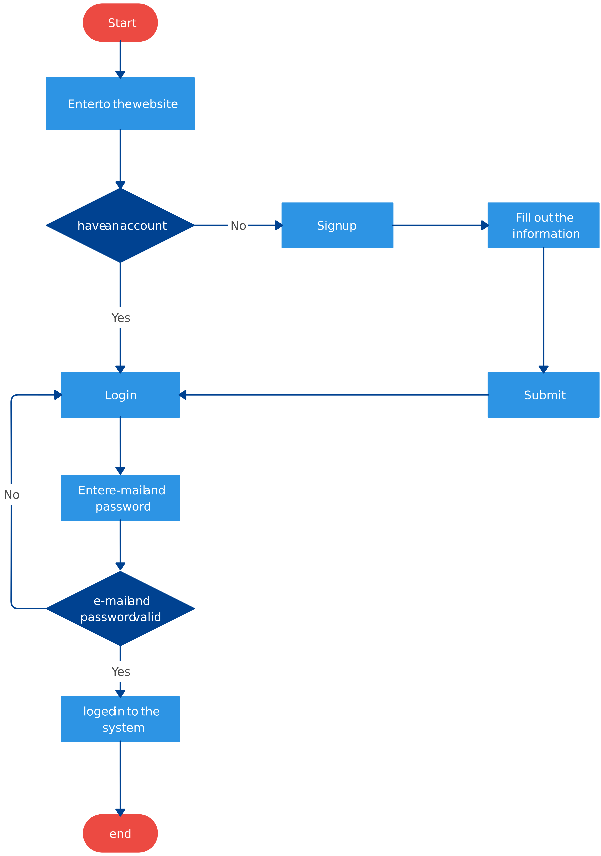
Flow Chart

Slide 8
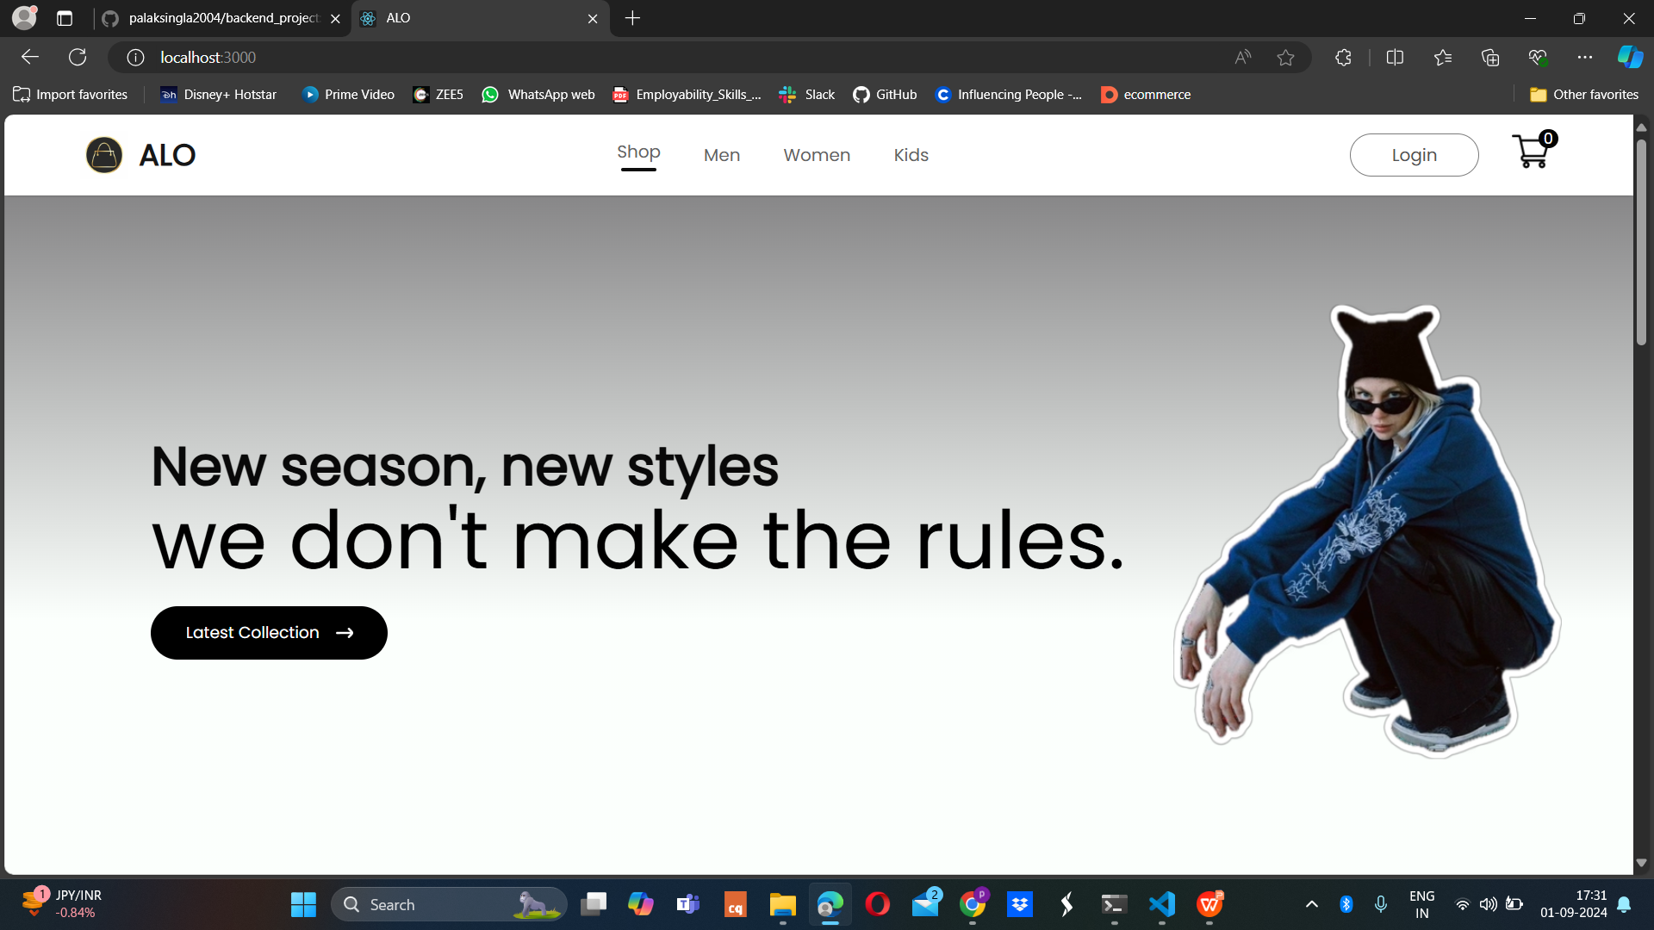
Result
This is the front page of our website and here we can see “Login” option in the navbar.

Slide 9
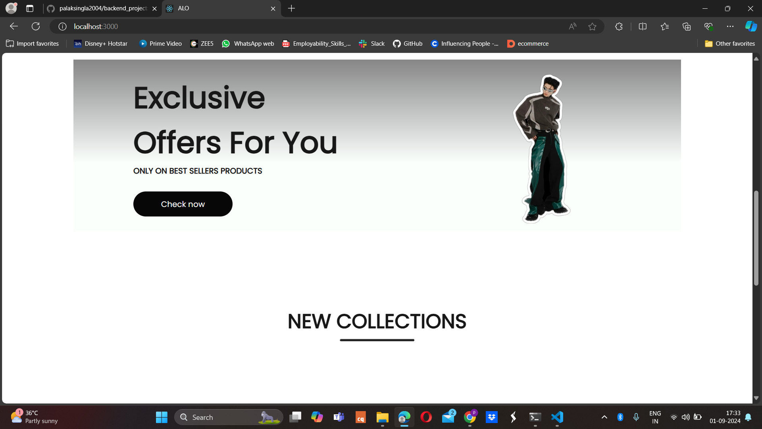
Result
On scrolling down, we get to see new collections.

Slide 10
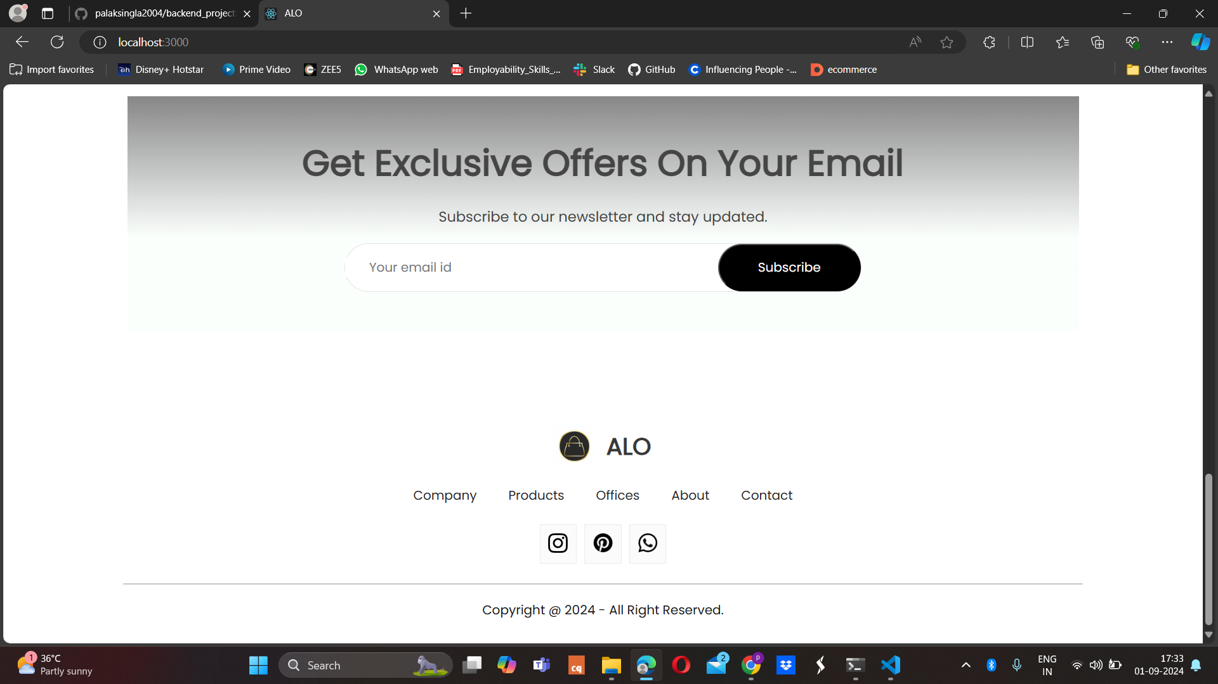
Result

Slide 11
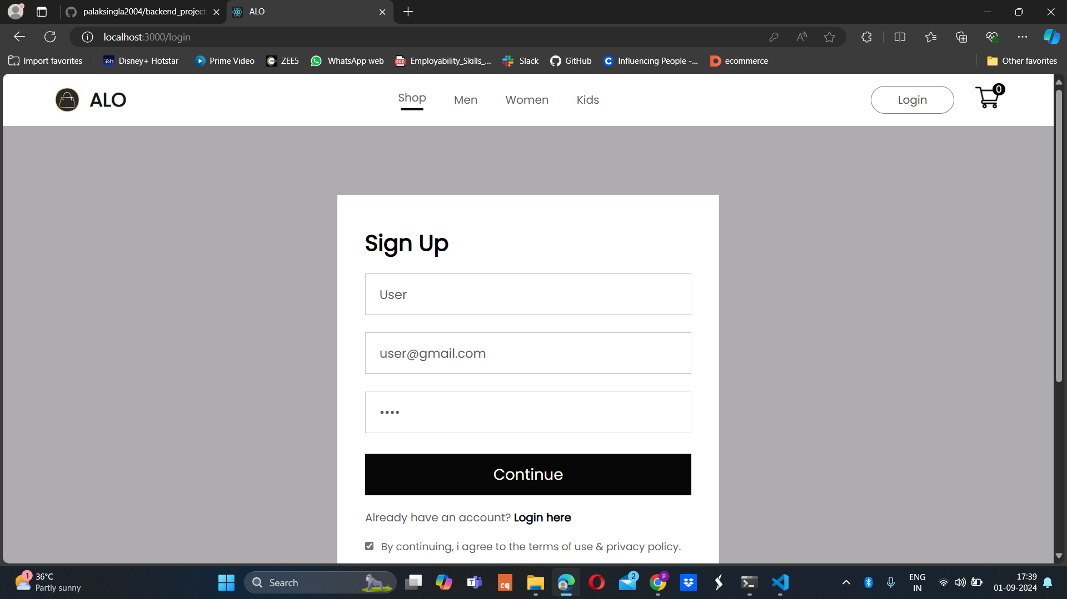
Result
On clicking the "Login" button ,signup page open ups where the user has to fill in the details

Slide 12
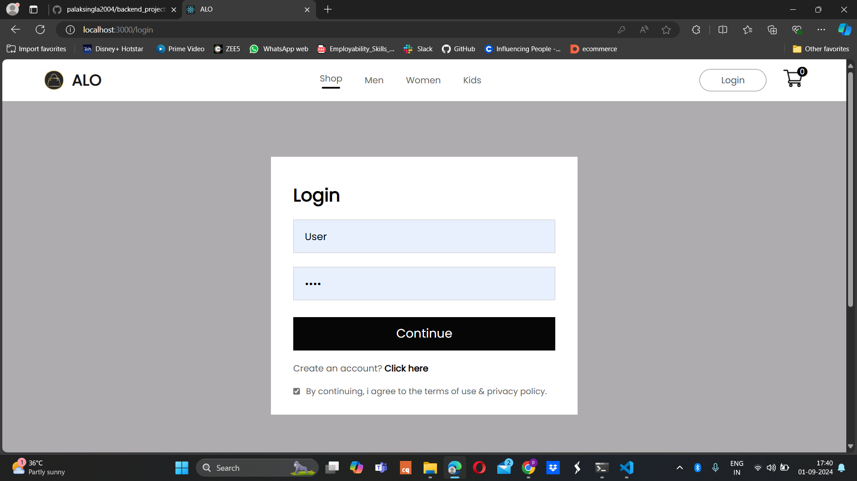
Result
If the user has already logged in, he/she can just fill in the details and proceed.

Slide 13
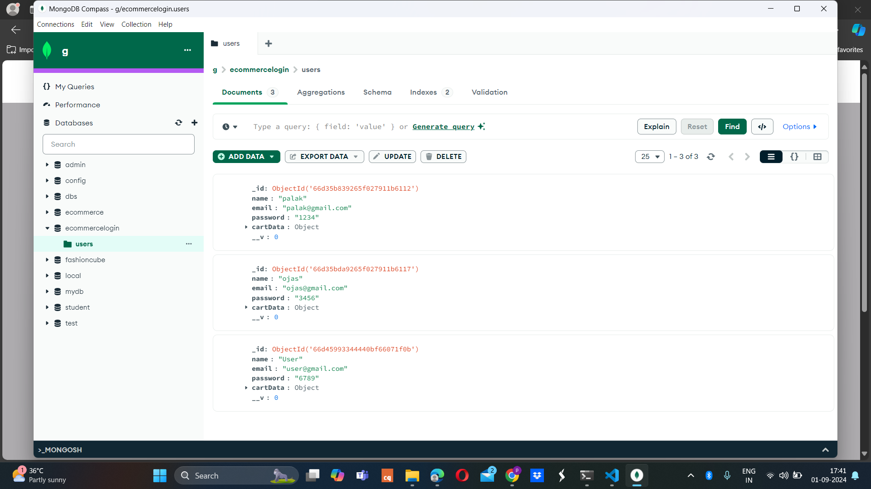
Result
The user details get stored in mongoDB.

Slide 14

Result
And now you can see "Login" option has changed to "Logout".

Slide 15
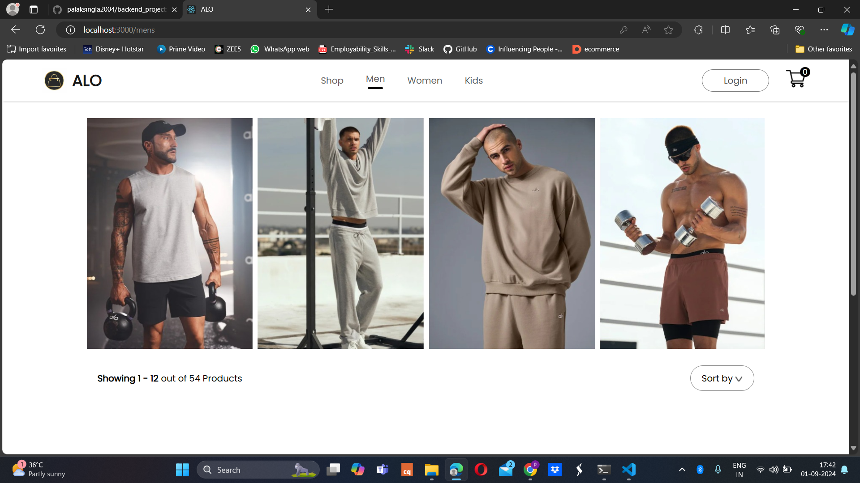
Result

Slide 16
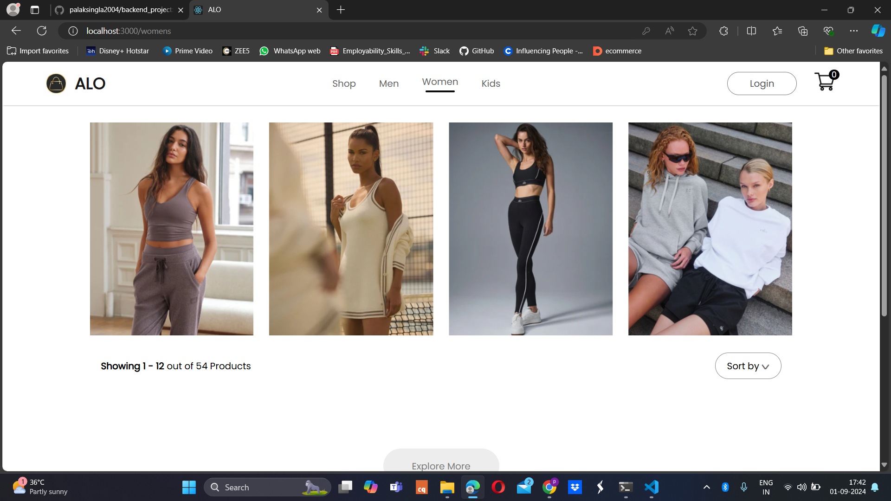
Result

Slide 17
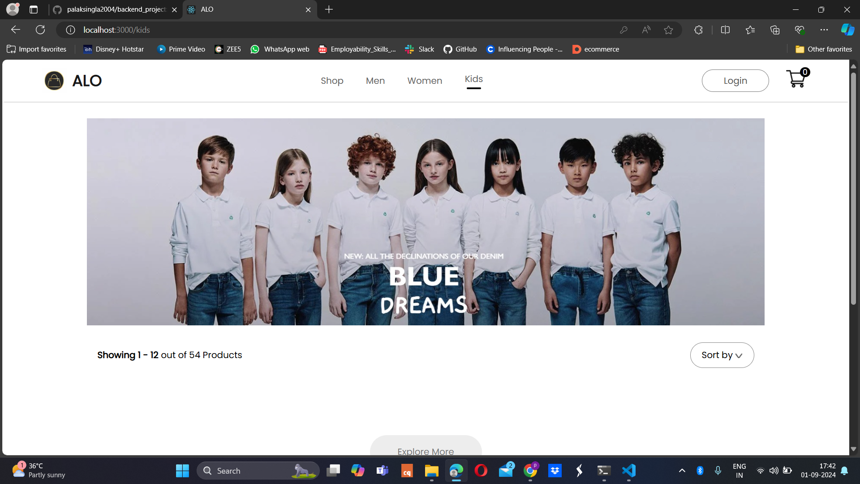
Result

Slide 18
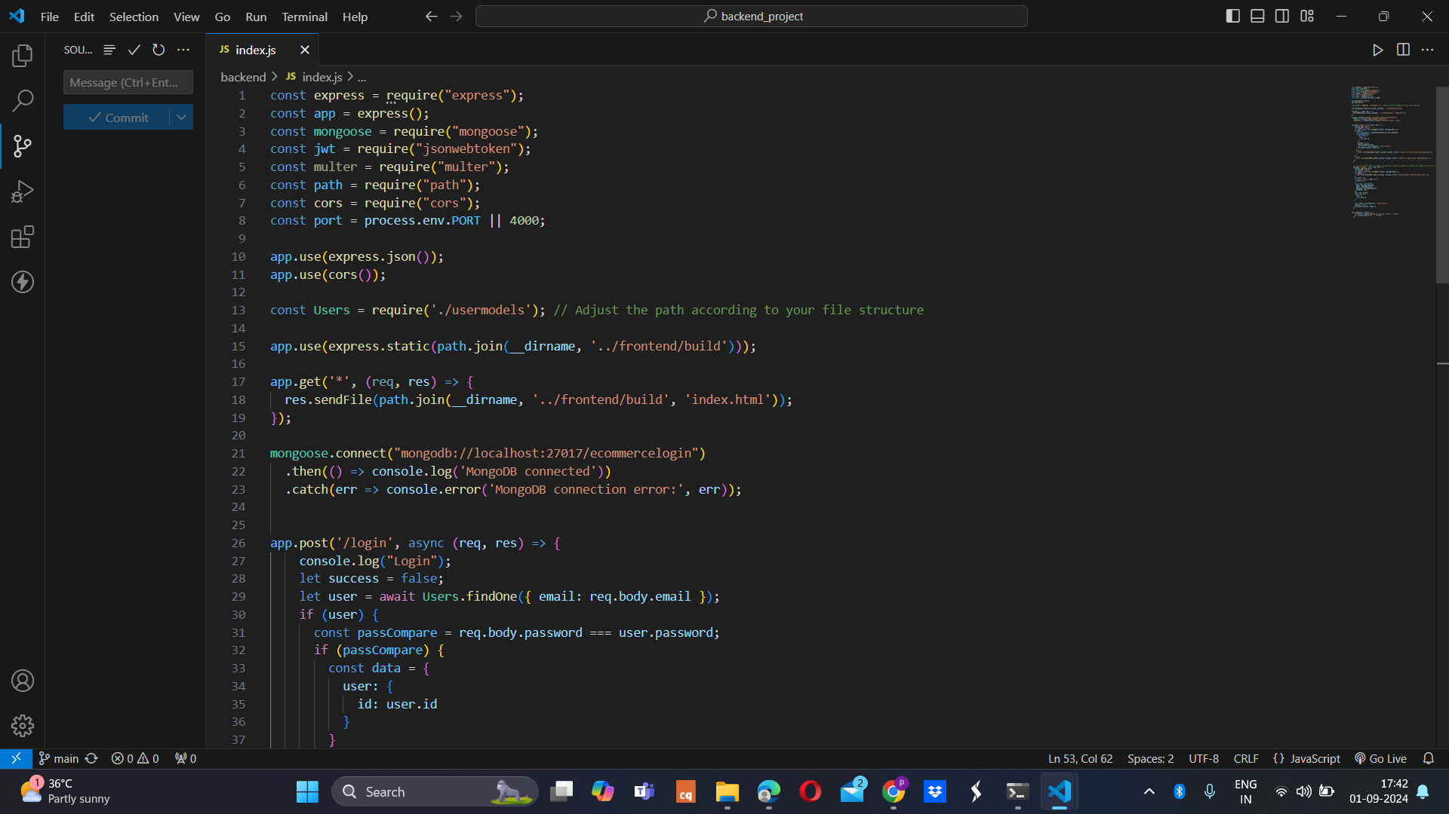
Source Code

Slide 19
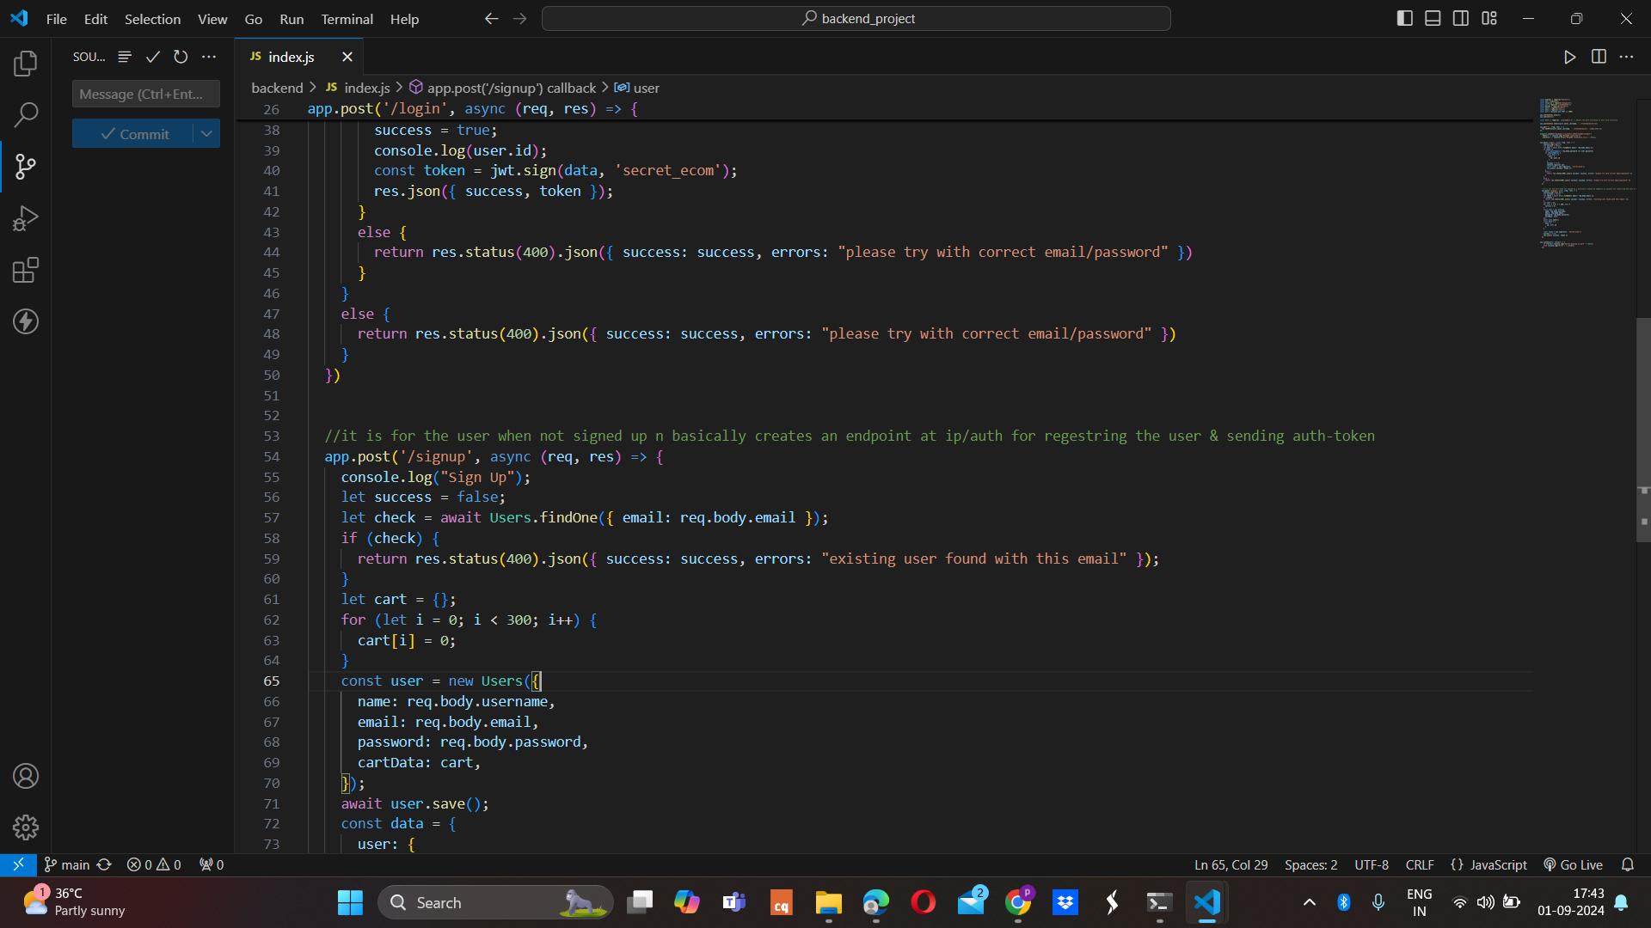
Source Code

Slide 20
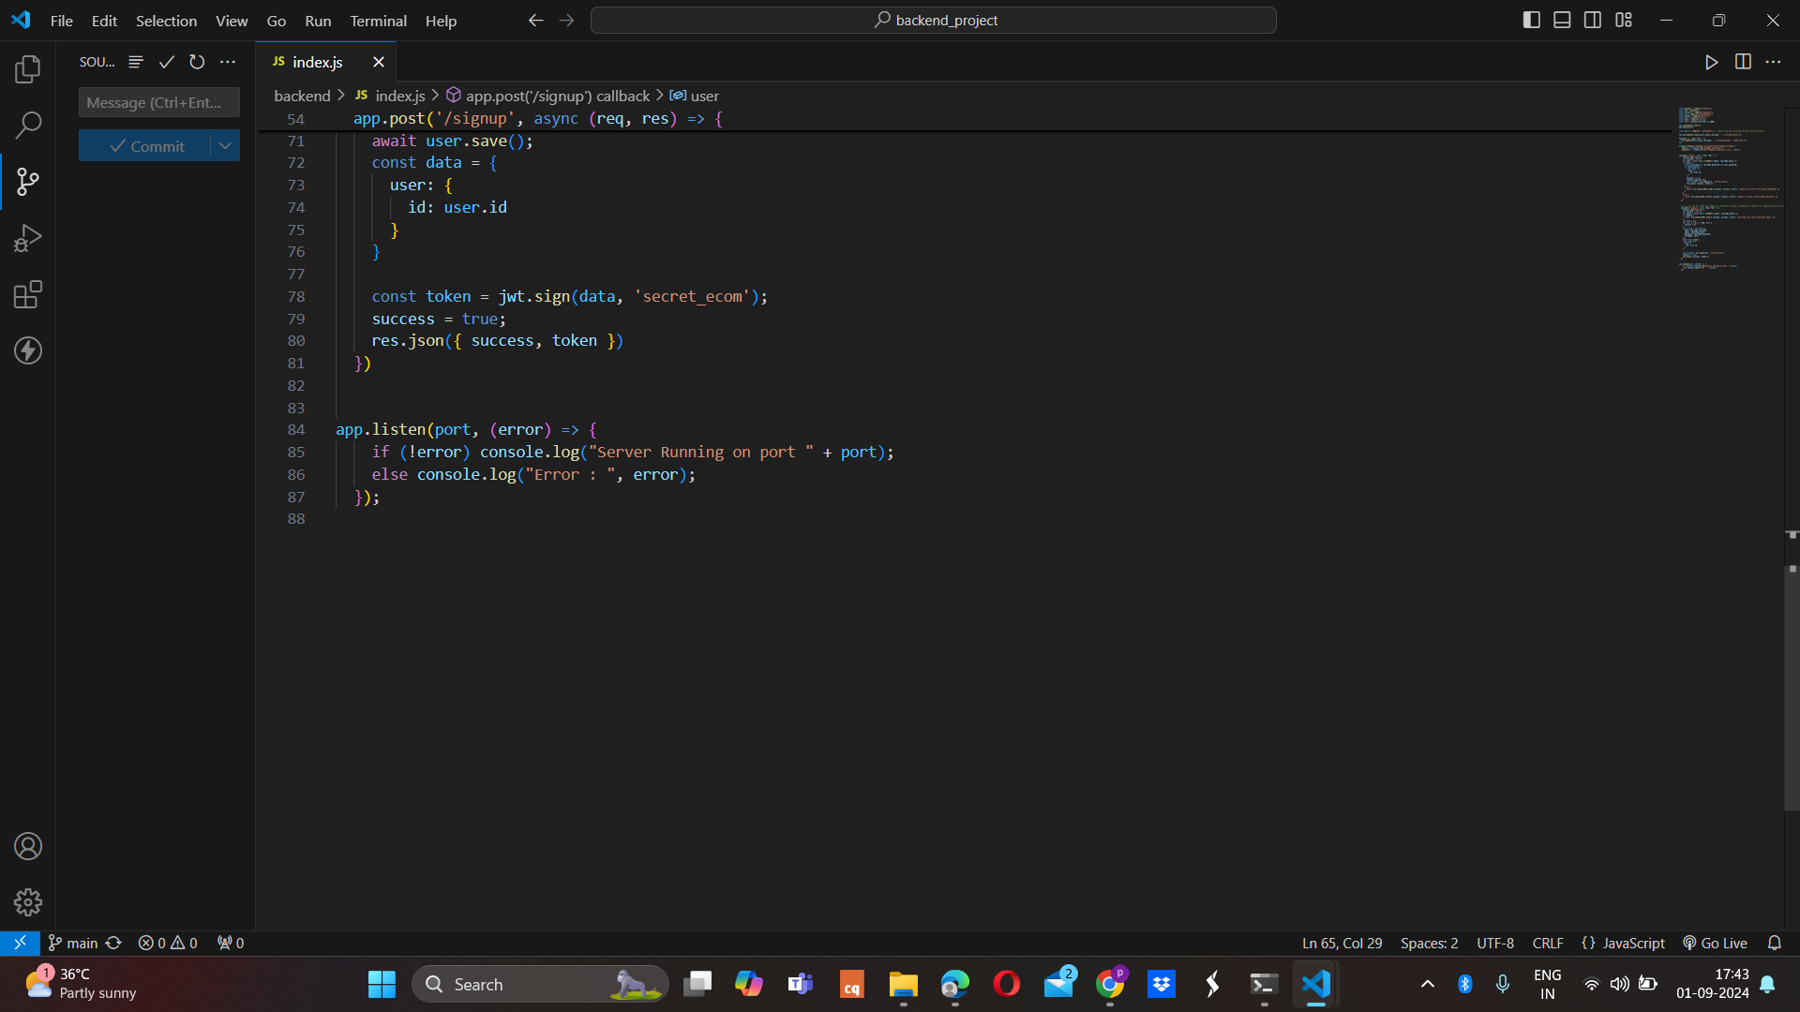
Source Code

Slide 21
Conclusion
In conclusion, this website has successfully achieved its objective of implementing a user-friendly authentication system within an e-commerce platform using modern web technologies. By leveraging the MERN stack—MongoDB for database management, Express.js for backend operations, React.js for the frontend, and Node.js as the runtime environment—the project demonstrates a robust and scalable approach to user authentication.

Slide 22
Future Scope
Payment Gateway
Wishlist Customisation
Cart Management

Slide 23
Reference
[1] https://reactjsexample.com/tag/ecommerce/ , Accessed on July 28,2024
[2] http://chat.openai.com/chat , Accessed on Aug 29,2024
[3] https://www.geeksforgeeks.org/express-js/ , Accessed on Aug 2,2024
[4]https://www.mongodb.com/docs/manual/crud/ , Accessed on Aug 27,2024

Slide 24


